Slide 1
Decision-Making Tools
A
MODULE

Slide 2

Golden Rule…
Approximately right but not absolutely wrong

Slide 3
The Decision Process in Operations
Clearly define the problem and the factors that influence it
Develop specific and measurable objectives
Develop a model
Evaluate each alternative solution
Select the best alternative
Implement the decision and set a timetable for completion
Notes:
This slide provides some reasons that capacity is an issue. The following slides guide a discussion of capacity.

Slide 4
Decision Making Terms
Alternative
A course of action or strategy that may be chosen by the decision maker
Left or Right
Build small or large factory
State of nature
An occurrence or a situation over which the decision maker has little or no control
Gravity = 9.8 m/s
Stock market increases
Notes:
This slide can be used to frame a discussion of capacity.
Points to be made might include:
- capacity definition and measurement is necessary if we are to develop a production schedule
- while a process may have “maximum” capacity, many factors prevent us from achieving that capacity on a continuous basis.
Students should be asked to suggest factors which might prevent one from achieving maximum capacity.

Slide 5
Payoff Table
Payoff table
Method for organizing and illustrating payoffs from different decisions given various states of nature
Payoff
Outcome of a decision
States Of Nature
Decision a b
1 Payoff 1a Payoff 1b
2 Payoff 2a Payoff 2b

Slide 6
Uncertainty – Maximax
Find the alternative that maximizes the maximum outcome for every alternative
Pick the outcome with the maximum number
Highest possible gain
This is viewed as an optimistic decision criteria

Slide 7
Uncertainty – Maximin
Find the alternative that maximizes the minimum outcome for every alternative
Pick the outcome with the minimum number
Least possible loss
This is viewed as a pessimistic decision criteria

Slide 8
Uncertainty – Equally Likely
Find the alternative with the highest average outcome
Pick the outcome with the maximum number
Assumes each state of nature is equally likely to occur

Slide 9
Choosing Decision Tool
Establishing the procedure to follow
Construct the
Payoff table
Decision-making
under complete
uncertainty
Decision-making
under risk
Decision-making
under certainty
Maximin Approach
Maximax Approach
Minimax regret Approach
Insufficient Reason Approach
Expected Monetary Value (EMV) Approach
Expected Opportunity Loss (EOL) Approach
Expected Value of Perfect Information (EVPI) Approach
9

Slide 10
Important Point
Reality…
Whether you do an analysis the “right way” or the “wrong way”, the analysis itself can be at least as useful as the result

Slide 11
Expected Monetary Value

Slide 12
Decision Making Under Risk
Each possible state of nature has an assumed probability
States of nature are mutually exclusive
Probabilities must sum to 1
Determine the expected monetary value (EMV) for each alternative

Slide 13
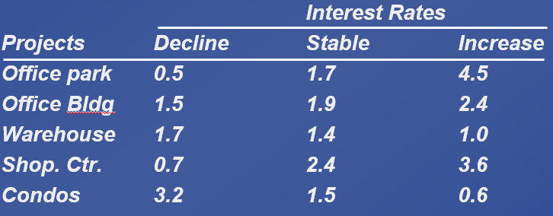
Expected Value – Bank Example
Assume for our previous example that there is a 50% chance of a decline, a 35% of stable rates, and a 15% chance of an increase

Slide 14
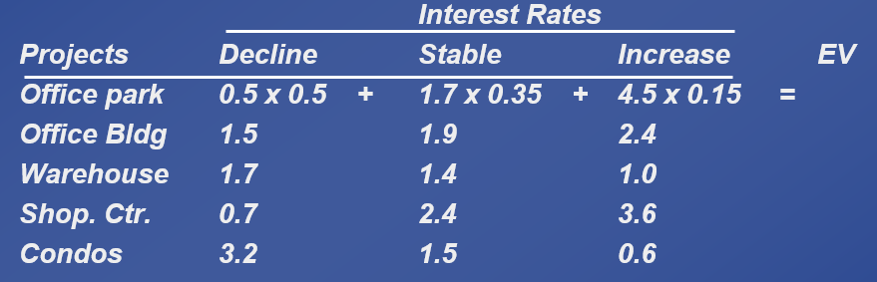
Expected Value – Bank Example
Assume for our previous example that there is a 50% chance of a decline, a 35% of stable rates, and a 15% chance of an increase
Compute the following expected values for each decision

Slide 15
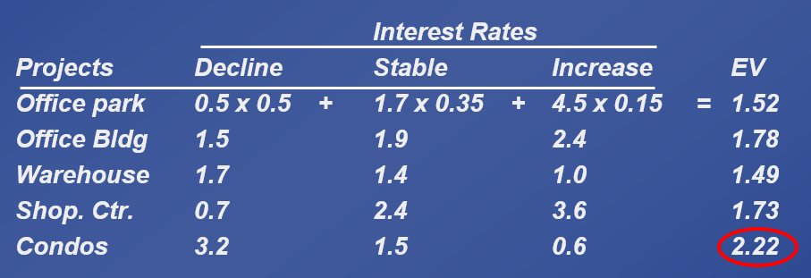
Expected Value – Bank Example
Assume for our previous example that there is a 50% chance of a decline, a 35% of stable rates, and a 15% chance of an increase
Compute the following expected values for each decision
Using these probabilities we would select Condos

Slide 16
ExcelOM – Expected Value
Enter the previous problem into ExcelOM

Slide 17
Decision with Perfect Information

Slide 18
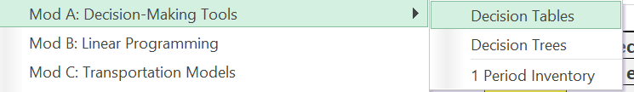
Decision Making Under Certainty
Is the cost of perfect information worth it?
Determine the expected value of perfect information (EVPI)
Use ExcelOM template Decision Tables
Notes:
It might be useful at this point to discuss typical equipment utilization rates for different process strategies if you have not done so before.

Slide 19
Expected Value of Perfect Information
EVPI is the difference between the payoff under certainty and the payoff under risk
Expected value with perfect information
EVPI = –
Maximum EMV
Expected value with perfect information (EVwPI) | = | (Best outcome or consequence for 1st state of nature) x (Probability of 1st state of nature)
 | + | Best outcome for 2nd state of nature) x (Probability of 2nd state of nature)
 | + | … + Best outcome for last state of nature) x (Probability of last state of nature)

Slide 20
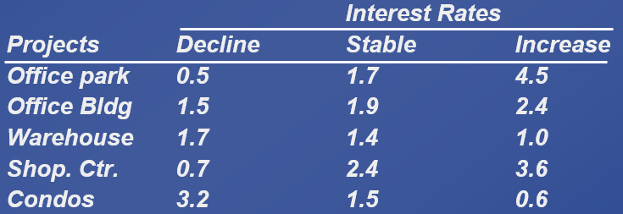
Expected Value Under Certainty
What would we do if we knew which scenario would come true?
Pick the decision that has the highest value for that column!
If we then weight these values by the corresponding probabilities and sum we get EVUC.
50% chance of a decline, a 35% of stable rates, and a 15% chance of an increase

Slide 21
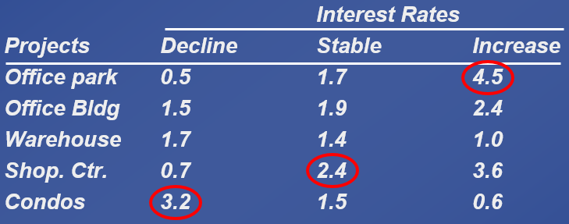
Expected Value Under Certainty
Pick the decision that has the highest value for that column
If we then weight these values by the corresponding probabilities and sum we get EVUC
50% chance of a decline, a 35% of stable rates, and a 15% chance of an increase
EVUC = 3.2 x 0.50 + 2.4 x 0.35 + 4.5 x 0.15 = 3.12

Slide 22
Expected Value of Perfect Information
Expected Value Under Certainty is not much good on its own, but can be used to compute the Expected Value of Perfect Information = EVPI
We simply subtract what we get without perfect information (EMV) from EVUC
In this case we have:
EVPI = 3.12 – 2.22 = 0.90
Expected value with perfect information
(EVwPI)
EVPI = –
Maximum EMV

Slide 23
ExcelOM – Expected Value
Enter the previous problem into ExcelOM
*Corrected from video

Slide 24
EMV Example
 | STATES OF NATURE
ALTERNATIVES | FAVORABLE MARKET | UNFAVORABLE MARKET
Construct large plant (A₁) | $200,000 | –$180,000
Construct small plant (A₂) | $100,000 | –$ 20,000
Do nothing (A₃) | $ 0 | $ 0
Probabilities | 60% | 40%
Given this data, what is the best option?
Notes:
It might be useful at this point to discuss typical equipment utilization rates for different process strategies if you have not done so before.

Slide 25
EMV Example
 | STATES OF NATURE
ALTERNATIVES | FAVORABLE MARKET | UNFAVORABLE MARKET
Construct large plant (A₁) | $200,000 | –$180,000
Construct small plant (A₂) | $100,000 | –$ 20,000
Do nothing (A₃) | $ 0 | $ 0
Probabilities | 0.6 | 0.4
EMV(A₁) = (0.6)($200,000) + (0.4)(–$180,000) = $48,000
EMV(A₂) = (0.6)($100,000) + (0.4)(–$20,000) = $52,000
EMV(A₃) = (0.6)($0) + (0.4)($0) = $0
Notes:
It might be useful at this point to discuss typical equipment utilization rates for different process strategies if you have not done so before.

Slide 26
EVPI Example
How much should this company should pay for perfect information?
NOTE: Perfect information can be considered market research data.

Slide 27
EVPI Example
Determine best outcome for each state of nature
EVwPI = ($200,000)(.6) + ($0)(.4) = $120,000

Slide 28
EVPI Example
The maximum EMV is $52,000, which is the expected outcome without perfect information]
EVPI = EVwPI – Max EMV
EVPI = $120,000 – $52,000 = $68,000
The most the company should pay for market research is $68,000

Slide 29
ExcelOM – EVPI
Enter the previous problem into ExcelOM

Slide 30
Decision Trees
Information in decision tables can be displayed as decision trees
A decision tree is a graphic display of the decision process that indicates decision alternatives, states of nature and their respective probabilities, and payoffs for each combination of decision alternative and state of nature
Appropriate for showing sequential decisions

Slide 31
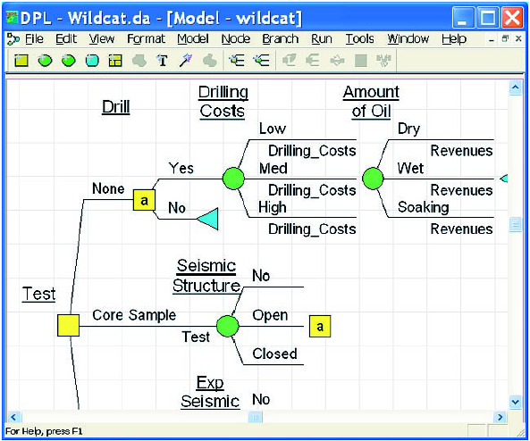
Decision Trees

Slide 32
Decision Trees
Define the problem
Structure or draw the decision tree
Assign probabilities to the states of nature
Estimate payoffs for each possible combination of decision alternatives and states of nature
Solve the problem by working backward through the tree computing the EMV for each state-of-nature node

Slide 33
Decision Tree Example
EMV for node 1
= $48,000
= (0.6)($200,000) + (0.4)(–$180,000)
Payoffs
Favorable market (.6)
$200,000
1
Unfavorable market (.4)
Construct large plant
–$180,000
Favorable market (.6)
$100,000
Construct small plant
2
Unfavorable market (.4)
–$20,000
Do nothing
EMV for node 2
= $52,000
= (0.6)($100,000) + (0.4)(–$20,000)
EMV for Do nothing = $0
$0
Figure A.2

Slide 34
Moving Averages
MA is a series of arithmetic means
Used if little or no trend
Used often for smoothing
Provides overall impression of data over time
3 month moving average is common
Average the previous 3 months

Slide 35
Moving Average Example
MONTH | ACTUAL SHED SALES | 3-MONTH MOVING AVERAGE
January | 10
February | 12
March | 13
April | 16
May | 19
June | 23
July | 26
August | 30
September | 28
October | 18
November | 16
December | 14
10
12
13
(10 + 12 + 13)/3 = 11.7
(12 + 13 + 16)/3 = 13.7
(13 + 16 + 19)/3 = 16.0
(16 + 19 + 23)/3 = 19.3
(19 + 23 + 26)/3 = 22.7
(23 + 26 + 30)/3 = 26.3
(26 + 30 + 28)/3 = 28.0
(30 + 28 + 18)/3 = 25.3
(28 + 18 + 16)/3 = 20.7

Slide 36
Moving Average Forecast
A product your factory produces has the following historical demand
What is the three month moving average for November?
Use ExcelOM
Month | Demand
January | 120
February | 90
March | 100
April | 75
May | 110
June | 50
July | 75
August | 130
September | 110
October | 90

Slide 37
Moving Average Forecast
A product your factory produces has the following historical demand
What is the three month moving average for November?
Use ExcelOM
Month | Demand
January | 120
February | 90
March | 100
April | 75
May | 110
June | 50
July | 75
August | 130
September | 110
October | 90
November = 110 units

